Slide 1
A CLOUD BASED SMART PARKING SYSTEM BASED ON INTERNET- OF –THINGS TECHNOLOGIES
UNDER THE GUIDANCE OF: BY:
S.GLADSON OLIVER , M.Tech., p.DEEPA (1318103)
ASSistant PROFESSOR(IT) k.EGNESWARI (1318110)
GOVERNMENT COLLEGE OF TECHNOLOGY P.SUKIRTHA (1318143)
M.SANDHIYA (1318L05)

Slide 2
OBJECTIVE
To implement a smart parking system by developing a network architecture based on Internet-of-Things technology.

Slide 3
EXISTING SYSTEM
There is no proper transfer of data from the WSN(Wireless Sensor Networks) to the server.
There is no mathematical model for system operations.
There is no system performance evaluation.

Slide 4
PROPOSED SYSTEM
Achieves better performance.
Evaluation of the performance of the system through simulation.
Reduces the number of vehicles failing to find a parking space and cost of moving to the car park.
Helps users save time and money.
Reduces environmental pollution.

Slide 5
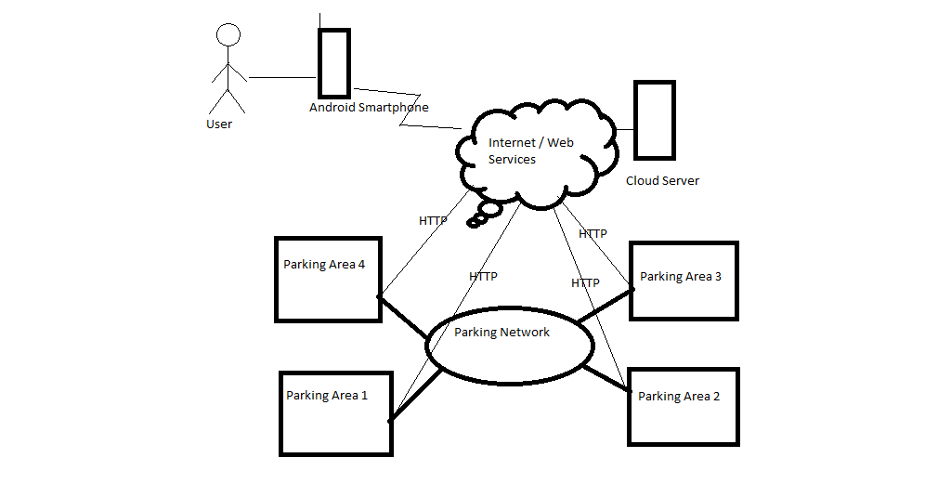
Block diagram

Slide 6

ARCHITECTURE
SYSTEM
Cloud-Based Server : Stores information provided by local units at car park.
Local Unit : Stores information of parking spaces.
Software Client : Used to reserve parking space.
NETWORK
Parking Network : Routers form the infrastructure for the connected clients.
Neighbor tables : F(α,β)- weighted link between two nodes in the parking networks.
$F_{ij}$=$F_{ij}$(α,β)=α*$d_{ij}$/$D_{up}$+β*$t_{j}$/$T_{up}$

Slide 7
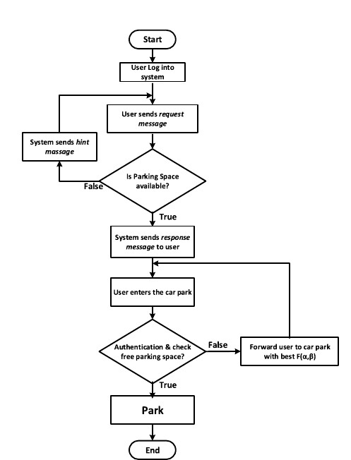
System operations

Slide 8
reference
X. Zhao, K. Zhao, and F. Hai, ‘‘An algorithm of parking planning for smart parking system,’’ in Proc. 11th World Congr. Intell. Control Autom. (WCICA), 2014
K. Ashokkumar, R. B. Sam, and B. Arshadprabhu, ‘‘Cloud based intelligent transport system,’’ in Proc. 2nd Int. Symp. Big Data Cloud Comput. (ISBCC), vol. 50. 2015

Slide 9
THANK YOU

